Slide 1
FPGA Adaptive Beamforming with HDL Coder and Zynq RFSoC

Slide 2
Agenda
Introduction: Motivation and Challenges
Applications: Radar, Comms and Wireless
Hardware FPGA challenges
Theory and Implementation
Linear algebra
QR Decomposition
Matrix Divide
Zynq RFSoC and HDL Coder Implementation
MATLAB MVDR reference code
HDL Coder implementation
Hardware Prototyping – live demo

Slide 3
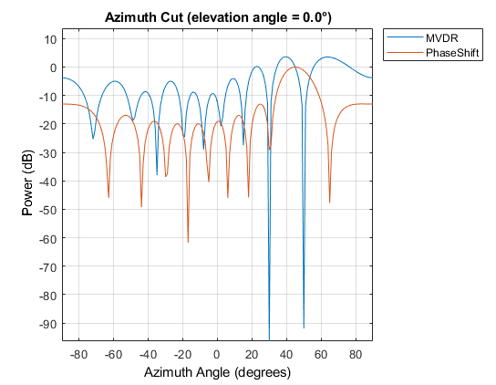
Adaptive Beamforming
Algorithm chooses optimal weights based on receive data statistics
Improve SNR by automatically placing nulls at interference angles
Signal of interest
w1
w2
+
w3
Interferer
w4
Adaptive Algorithm

Slide 4

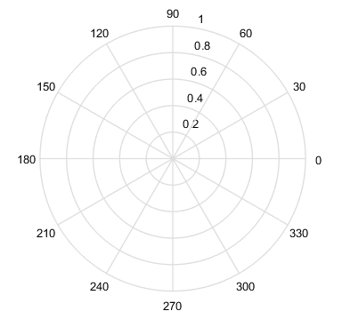
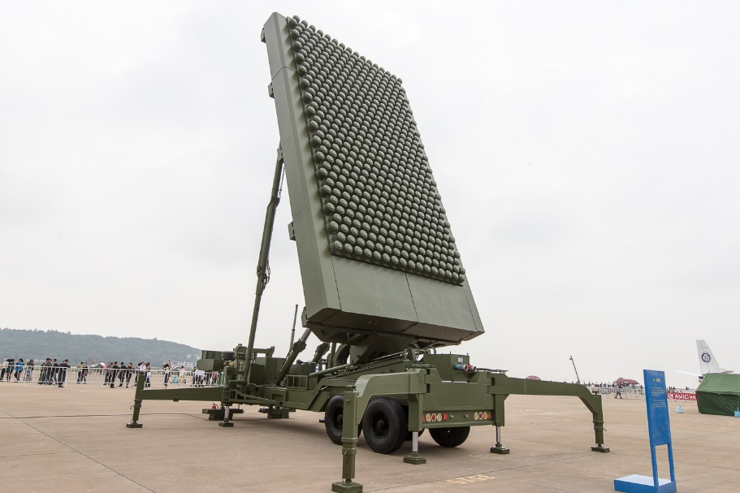
Applications: Radar
Increase angular resolution
Suppress interference

Slide 5
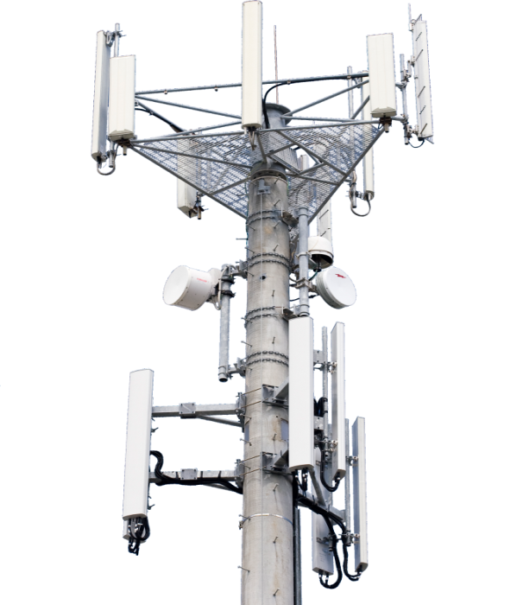

Applications: 5G
Increase number of simultaneous users
Improve throughput and coverage

Slide 6
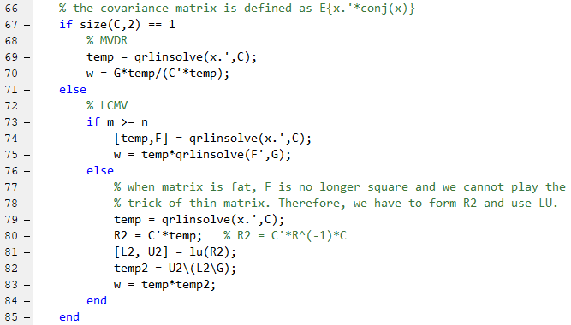
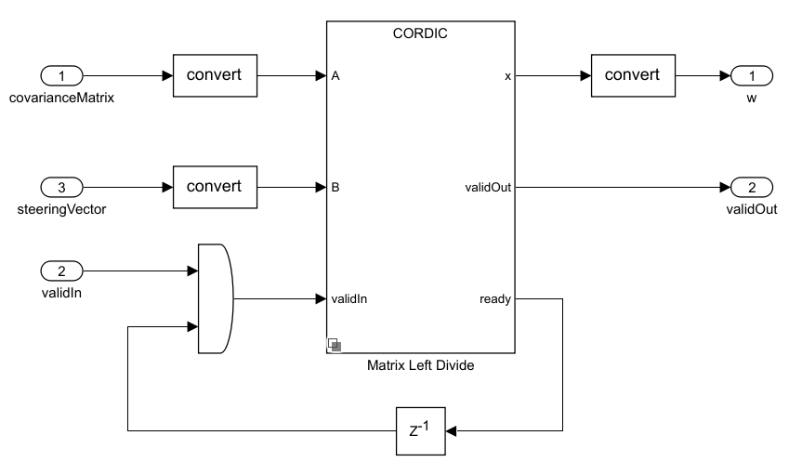
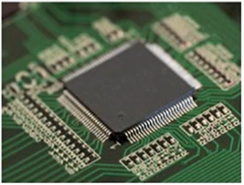
FPGA Implementation Challenges
Fixed-Point Math
Performance vs Area tradeoffs
Data Rate vs Clock Rate
Project Timeline

Slide 7
Agenda
Introduction: Motivation and Challenges
Applications: Radar, Comms and Wireless
Hardware FPGA challenges
Theory and Implementation
Linear algebra
QR Decomposition
Matrix Divide
Zynq RFSoC and HDL Coder Implementation
MATLAB MVDR reference code
HDL Coder implementation
Hardware Prototyping – live demo

Slide 19
Agenda
Introduction: Motivation and Challenges
Applications: Radar, Comms and Wireless
Hardware FPGA challenges
Theory and Implementation
Linear algebra
QR Decomposition
Matrix Divide
Zynq RFSoC and HDL Coder Implementation
MATLAB MVDR reference code
HDL Coder implementation
Hardware Prototyping – live demo

Slide 20

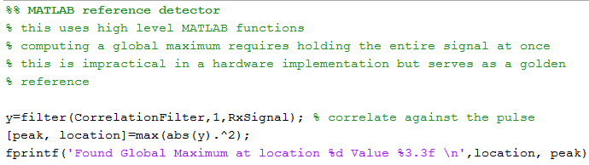
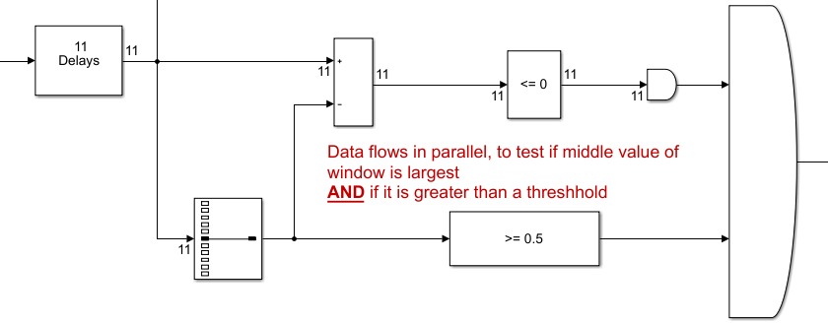

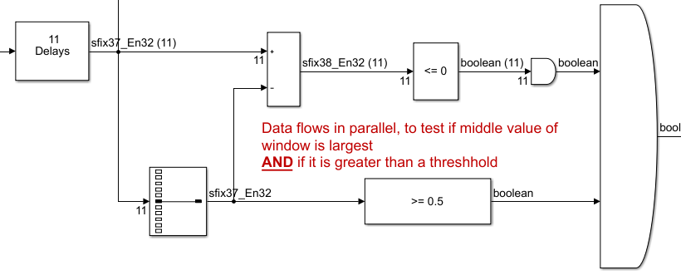
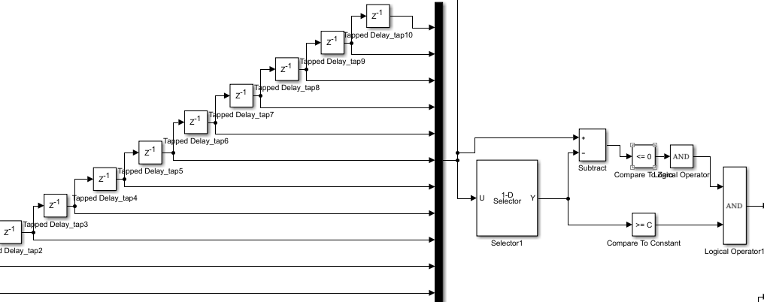
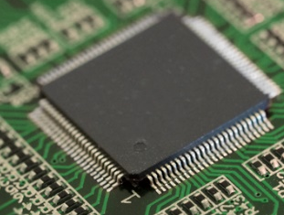
HDL Implementation Workflow
MATLAB Reference
MATLAB
Hardware Architecture
Fixed Point Designer
Fixed-point Implementation
Simulink
HDL Coder
HDL Code Generation and Optimization
Integrated Verification
HDL Verification and Targeting

Slide 21
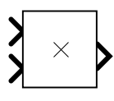
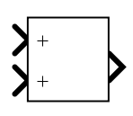
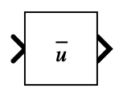
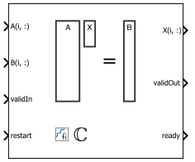

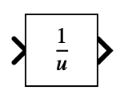
MATLAB MVDR reference code
function Y = mvdr_beamform(X, sv)
% form covariance matrix
Ecx = X.'*conj(X);
% compute weight vector
wp = Ecx\sv;
% normalize response
w = wp/(sv'*wp);
% form output beam
Y = X*conj(w);
end
100+ hours of design time saved!

Slide 22
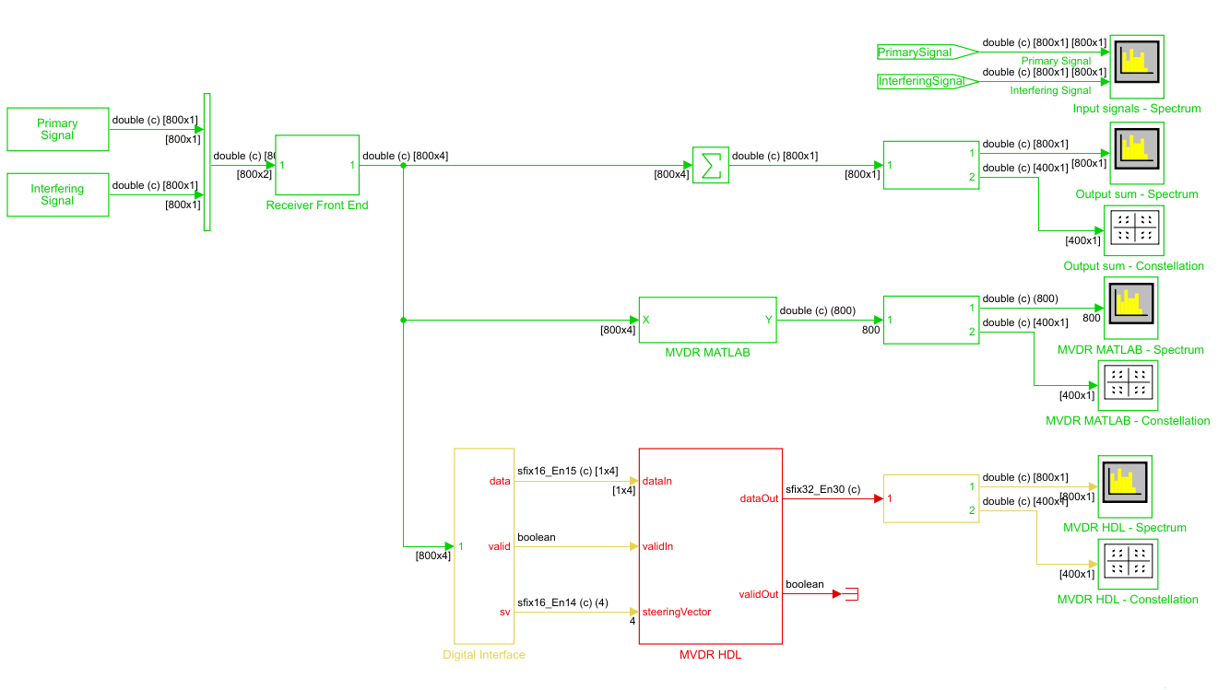
HDL Implementation of MVDR Beamforming

Slide 23
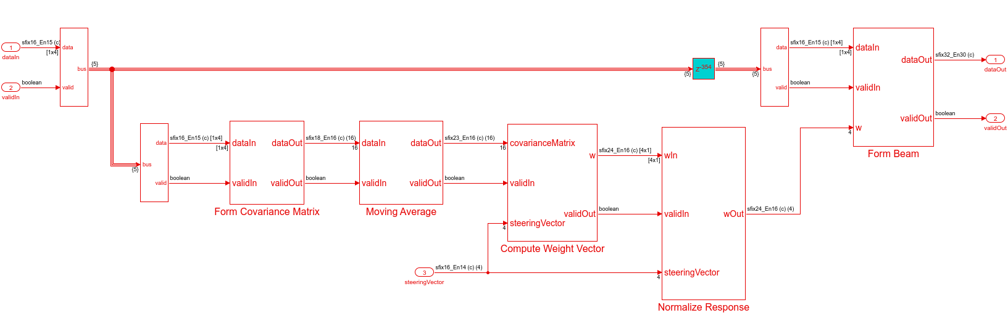
HDL Implementation of MVDR Beamforming

Slide 24
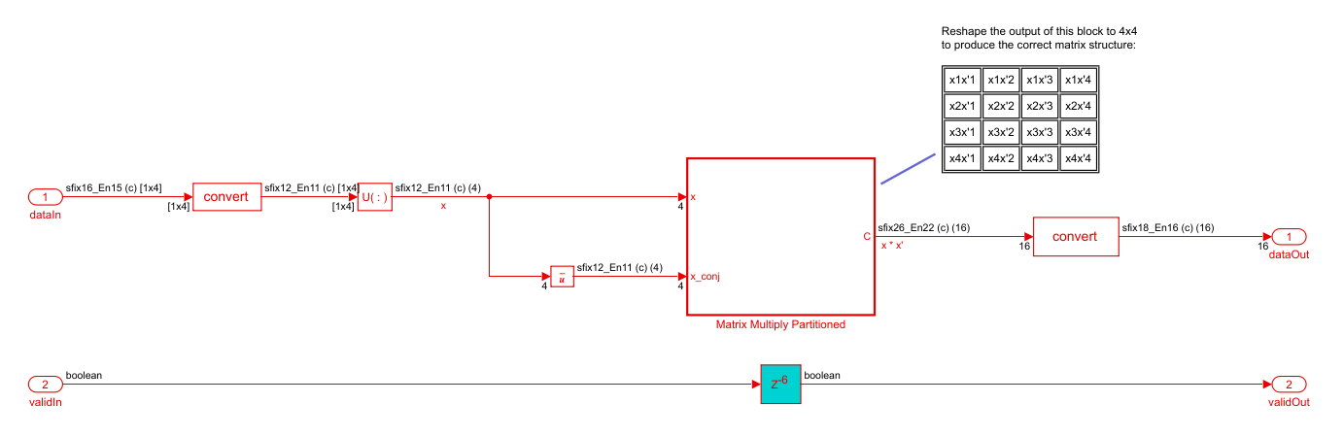
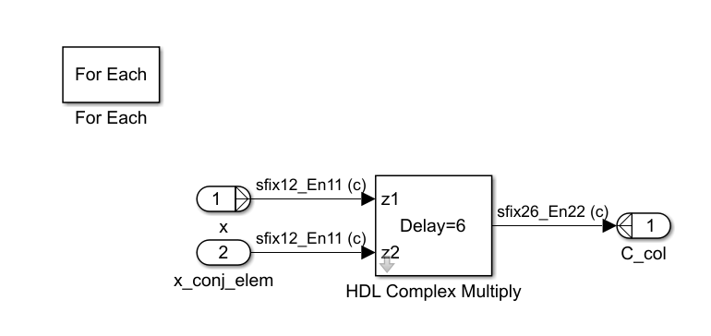
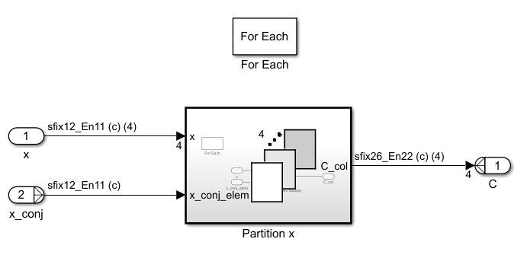
Form Covariance Matrix
For Each subsystem
Process elements independently
Concatenate results into outputs
% form covariance matrix
Ecx = X.'*conj(X);

Slide 25
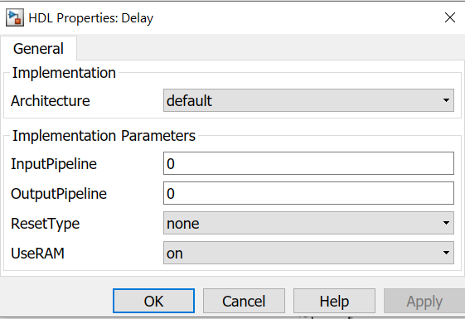
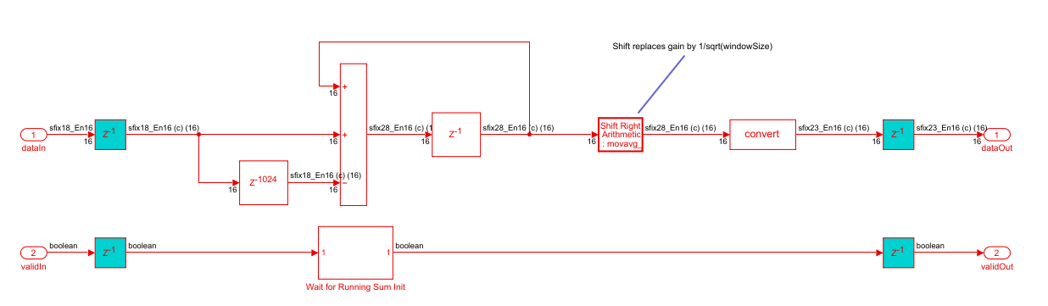
Moving Average
Use HDL Implementation properties to map large delays to Block RAM

Slide 26
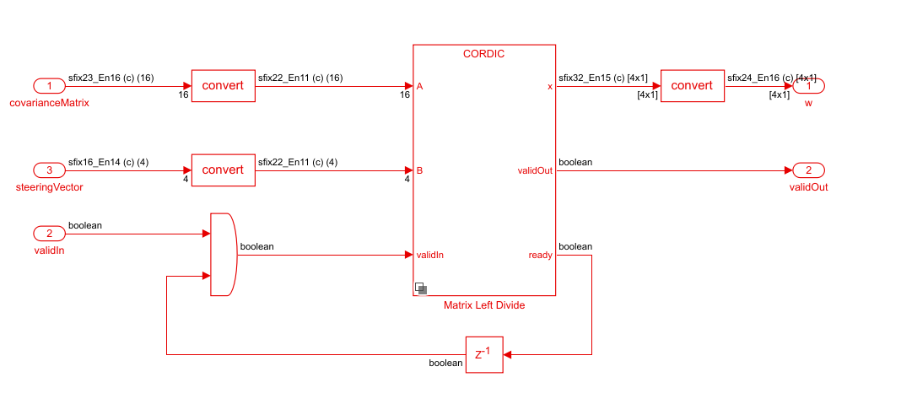
Compute Weight Vector
Use Systolic CORDIC Complex Matrix Solver
% compute weight vector
wp = Ecx\sv;
100+ hours of design time saved!
See the example model:
>> fi_complex_mldivide_systolic_array_model

Slide 27
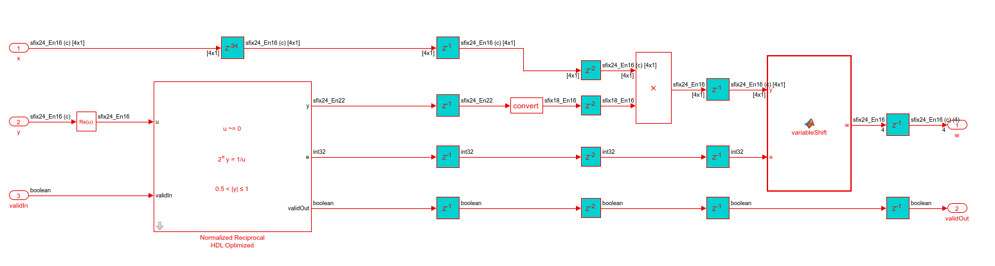
Normalize Response
Perform divide using reciprocal and multiply
Fixed-point CORDIC reciprocal “just works”
% normalize response
w = wp/(sv'*wp);

Slide 28

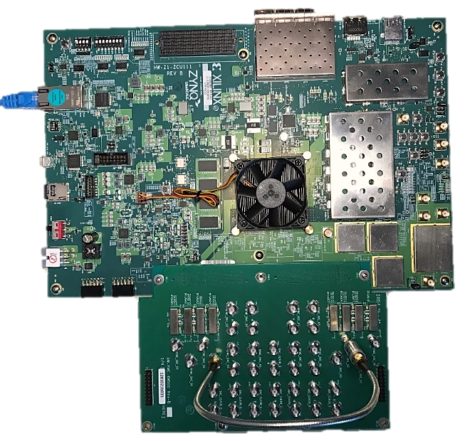
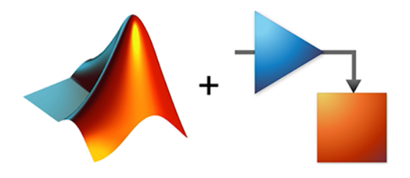
Implementation Results
Xilinx ZCU111 RFSoC Eval Board
MATLAB
Simulink
Device: xczu28dr (ZCU111)
Maximum frequency: 335.9 MHz
Resource utilization:
Ethernet
Resource | Utilization | (%)
LUT | 63K | 14.8
LUTRAM | 1.3K | 0.6
FF | 45K | 5.3
BRAM | 6 | 0.6
URAM | 8 | 10.0
DSP | 150 | 3.5

Slide 29
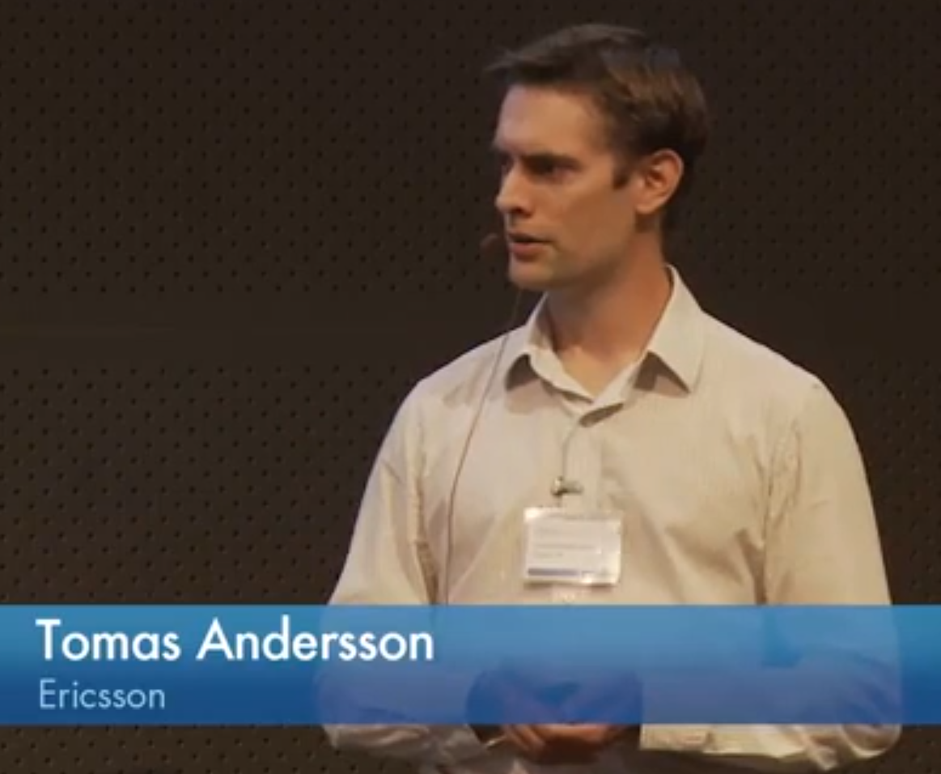
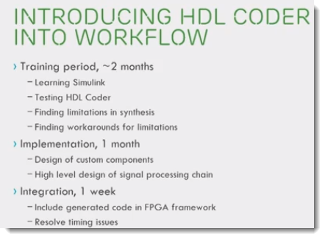
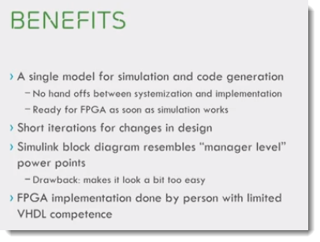
Resources to Get Started and Speed Adoption
Getting started:
MATLAB Onramp
Simulink Onramp
HDL pulse detector self-guided tutorial and videos
Proof-of-concept guided evaluations
FREE support via weekly WebEx meetings using custom sample designs
MathWorks coaches customers on “how to fish” through weekly WebEx sessions
Training & consulting services
HDL code generation, FPGA signal processing & Zynq programming training courses
Consulting service on deep technical coaching, custom design / hardware and more
Notes:
Please edit this to include other callouts specific to your event!

Slide 30
Q&A

